Slide 1
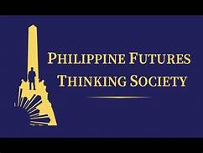
Futures Thinking: Its Implications to the Philippine Educational System
United Professionals for the Development and Advancement
of Teacher Education (PATEF-UPDATE), Inc.
May 17, 2023 | 10:30 AM
LIZAN E. PERANTE-CALINA, DPA

Slide 2
Contextualizing Education and Leadership in the 21st Century Era
Importance of Incorporating and Embedding Futures Thinking in Capacitating Educators
Phronetic Leadership and Futures Thinking as Frameworks Towards Shaping a Future where Education Matters
,
Notes:
Shared context
Different from other management and leadership theories
“ba”
Professor Ikujiro
End goal = agile and innovative local and national governments

Slide 3
Objectives
To promote a culture of anticipatory, agile and collaborative educational system; and to consider changing mindsets as a solution (using Hiraya Foresight and Futures Thinking under the Futures Leadership and Governance Framework) (Perante-Calina 2020)
To provide practical application of the framework to reflect the futures-readiness of the Philippine educational system

Slide 4
What are the implications of
COVID-19?
DISRUPTION. DISCONTINUITY. DISTURBANCE.

Slide 5
COVID-19 Pandemic has transformed the Philippine Education System.
Face-to-face Classes → Online Learning

Slide 6
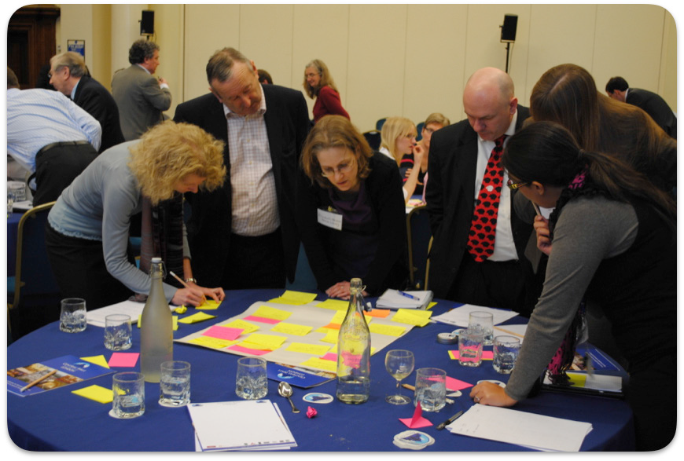
What is Futures Thinking?
‘Futures’ is an approach to identifying long term issues and challenges shaping the future development of a policy area and to exploring their implications for policy development.
Government Office for Science, The Futures Toolkit, 2017
Notes:
Futures thinking or futures studies has been introduced by many management practitioners, who call themselves “futurists” or “foresight practitioners”, in the past two decades. Under futures thinking, foresight is the widely used concept, which is defined as a “systematic and long-term in-depth study on scientific, technical, economic, environmental, and social processes” (Chen and Chiang 2010, p 3). Foresight has something to do with brain science that when searching for the future, the mind is wired with the past (Innayatullah 2018)

Slide 7
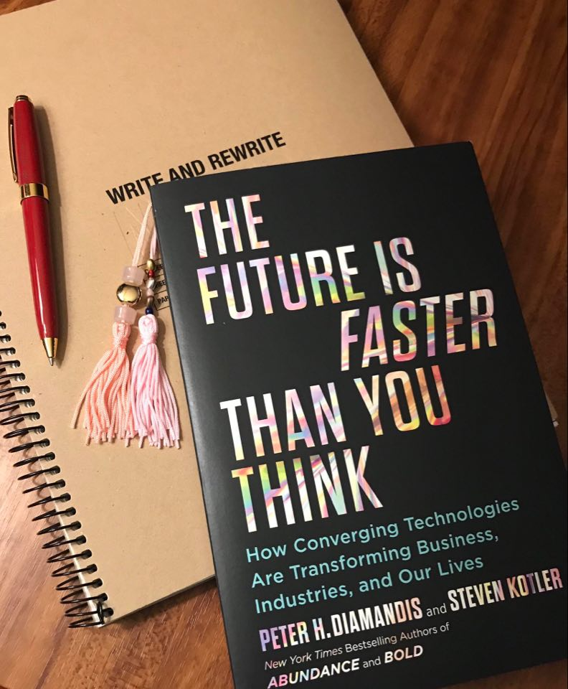
Futures Studies & Foresight
`
6 Ds of Exponentials (growth cycle of exponential technologies)
Digitalization
Deception
Disruption
Demonetization
Dematerialization
Democratization

Slide 8
Futures Studies & Foresight
Official European Union’s Definition
`
It brings together KEY AGENTS OF CHANGE and VARIOUS SOURCES in order to develop strategic visions and anticipatory intelligence.
Notes:
Futures thinking or futures studies has been introduced by many management practitioners, who call themselves “futurists” or “foresight practitioners”, in the past two decades. Under futures thinking, foresight is the widely used concept, which is defined as a “systematic and long-term in-depth study on scientific, technical, economic, environmental, and social processes” (Chen and Chiang 2010, p 3). Foresight has something to do with brain science that when searching for the future, the mind is wired with the past (Innayatullah 2018)

Slide 9
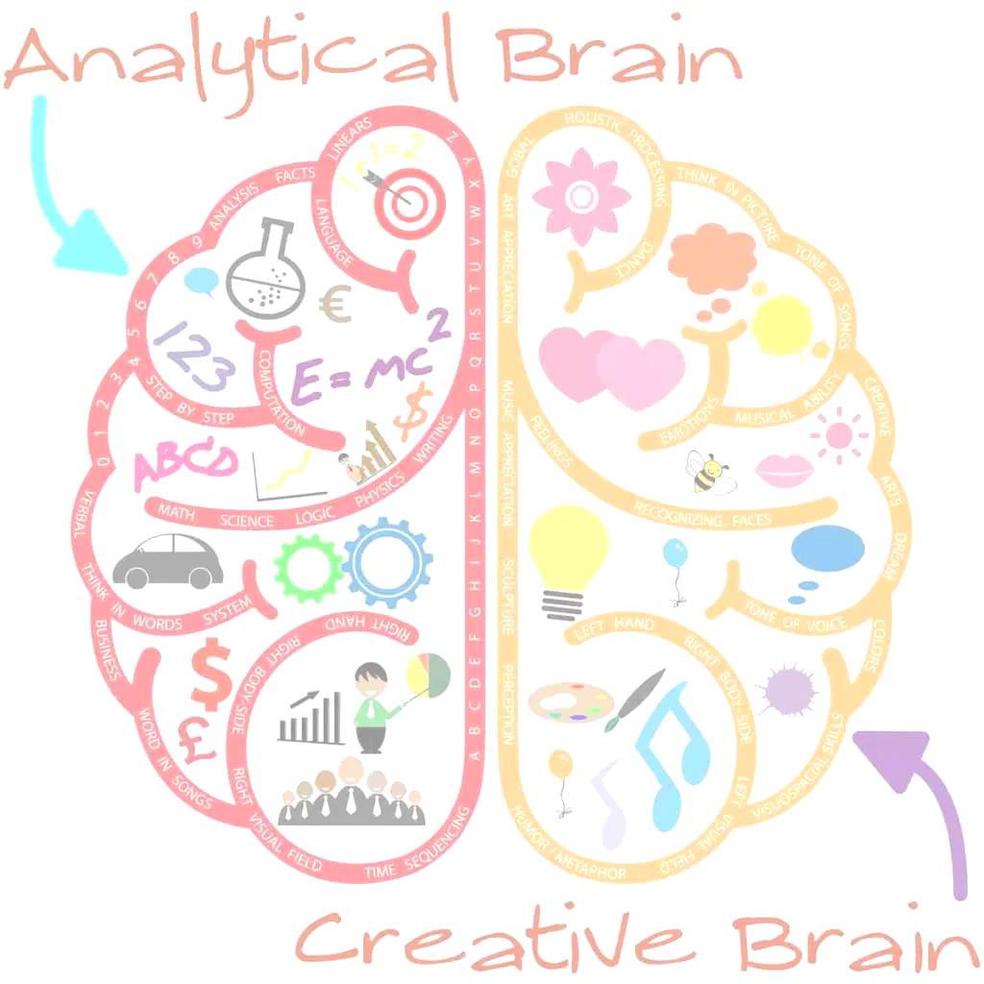
Futures Thinking and Strategic Foresight
NOT PREDICTING THE FUTURE
but rather to
IMAGINING MULTIPLE FUTURES IN CREATIVE WAYS
- Scoblic 2020
http://i0.wp.com/www.nwedible.com/wp-content/uploads/2015/03/Creative-Brain.jpg?resize=1024%2C1024

Slide 10
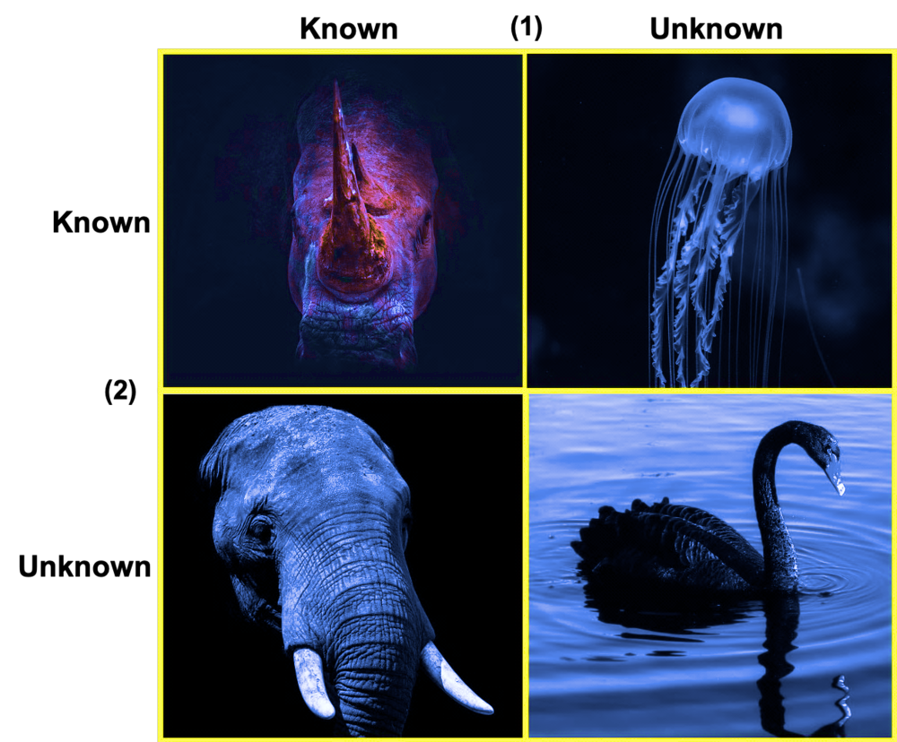
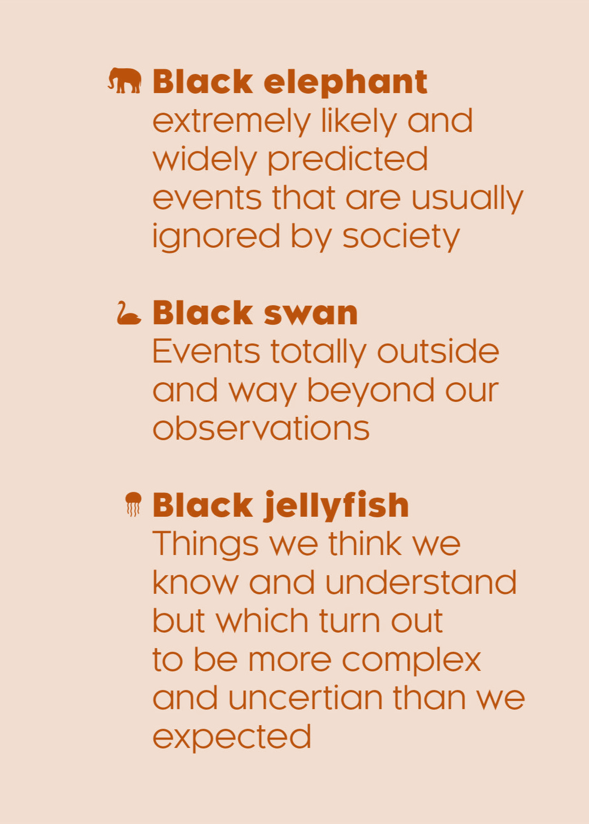
THE FUTURIST’S METAPHORICAL MENAGERIE
Robert Hickson • 16/03/2020
“Gray Rhino” refers to highly likely, high impact event (Michelle Wucker)

Slide 11
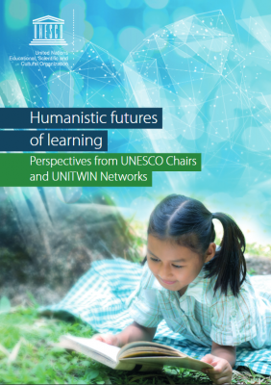
UNESCO’s Futures of Education Initiative
What will the world look like in 2050 and what role can education play in shaping the future?
https://unescochair-ghe.org/2020/02/13/unescos-futures-of-education-initiative/

Slide 12
The pandemic has only served to prove our fragility and our interconnectedness. Now urgent action, taken together, is needed to change course and reimagine our futures. This report by the International Commission on the Futures of Education acknowledges the power of education to bring about profound change.

Slide 13
What is Education 5.0?

Slide 14
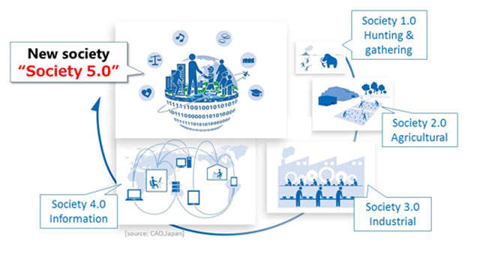
Society 5.0
"A human-centered society that balances economic advancement with the resolution of social problems by a system that highly integrates cyberspace and physical space." (CAO JAPAN)
Source: https://www8.cao.go.jp/cstp/english/society5_0/index.html?fbclid=IwAR1gAz2pAm8GkXYgiF3zuSjTxLD6PiD6NxkvLqENHCjYsVg0dGoB9FFpGzM
Notes:
In the information society (Society 4.0), cross-sectional sharing of knowledge and information was not enough, and cooperation was difficult.
Because there is a limit to what people can do, the task of finding the necessary information from overflowing information and analyzing it was a burden, and the labor and scope of action were restricted due to age and varying degrees of ability.

Slide 15
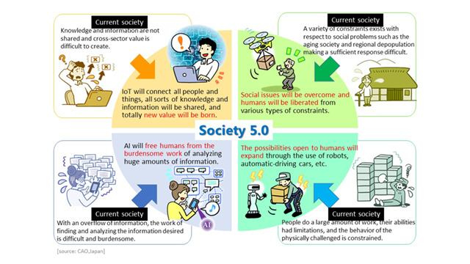
a forward-looking society that breaks stagnation whose members have mutual respect for each other, transcending the generations, and a society in which each and every person can lead an active and enjoyable life. (CAO JAPAN)
Society 5.0
Source: https://www8.cao.go.jp/cstp/english/society5_0/index.html?fbclid=IwAR1gAz2pAm8GkXYgiF3zuSjTxLD6PiD6NxkvLqENHCjYsVg0dGoB9FFpGzM

Slide 16
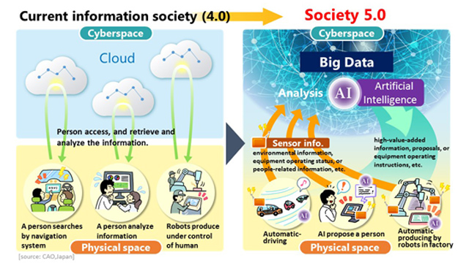
Society 5.0
achieves a high degree of convergence between cyberspace (virtual space) and physical space (real space). (CAO JAPAN)
people, things, and systems are all connected in cyberspace and optimal results obtained by AI exceeding the capabilities of humans are fed back to physical space.
Source: https://www8.cao.go.jp/cstp/english/society5_0/index.html?fbclid=IwAR1gAz2pAm8GkXYgiF3zuSjTxLD6PiD6NxkvLqENHCjYsVg0dGoB9FFpGzM

Slide 17
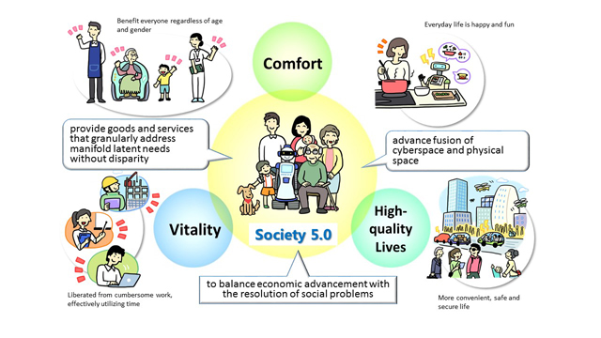
Society 5.0 Will Bring About a Human-centered Society
Source: https://www8.cao.go.jp/cstp/english/society5_0/index.html?fbclid=IwAR1gAz2pAm8GkXYgiF3zuSjTxLD6PiD6NxkvLqENHCjYsVg0dGoB9FFpGzM
Notes:
Society 5.0 achieves advanced convergence between cyberspace and physical space, enabling AI-based on big data and robots to perform or support as an agent the work and adjustments that humans have done up to now. This frees humans from everyday cumbersome work and tasks that they are not particularly good at, and through the creation of new value, it enables the provision of only those products and services that are needed to the people that need them at the time they are needed, thereby optimizing the entire social and organizational system.
This is a society centered on each and every person and not a future controled and monitored by AI and robots.

Slide 18
EDUCATION 5.0
Empower the learners to be equipped with knowledge and to be active members in their communities.
A valuable source of support and positive influence for young people.

Slide 19
THE WAY FORWARD IN LEARNERS’ DEVELOPMENT
Enhancing the Quality of Education and Training
Promoting Non Formal and Informal Education
Transforming and Expanding Skills Acquisition for the World of Work
Providing Alternative Learning Opportunities to Vulnerable Learners
https://www.un.org/esa/socdev/documents/youth/fact-sheets/youth-education.pdf

Slide 20
THE ROLE OF EDUCATORS FOR THE FUTURE
EDUCATORS have the ability to shape leaders of the future in the best way for society to build positive and inspired future generations and therefore design society, both on a local and global scale.
University of the People, 2019

Slide 21
Imperatives of Foresight and Futures Thinking in Governance
and Its Indigenization
(Perante-Calina, 2020)
Futures Thinking
21st competence or skill helpful to development and public leaders, and to its users, the policymakers themselves.
Use of Futures Thinking
contributes towards a better decision making and public policy making process
Notes:
And this leads me to the question - HOW TO FOSTER A GENERATIVE AND TRANSFORMATIONAL LEADERSHIP IN THE NEW NORMAL THROUGH HIRAYA FORESIGHT?

Slide 22
Focal Questions: Taking the Futures Thinking Lens
How will the future of the Philippine educational system look like in the next 18 months, in 5 years, 10 years or even 20 years?
What are the possible, plausible, probable and preferred futures of Philippine education?
What are the implications of COVID-19 to the Philippine Educational System?

Slide 23
NOW IS THE TIME TO FORMULATE STRATEGIES
TUNA
(Turbulence.Uncertain.Novel.Ambiguous.)
(Scoblic 2020)
ART
Adaptive. Resilient. Tranformative
https://i.ytimg.com/vi/1dQMDitiAw0/maxresdefault.jpg

Slide 24
`
Why
Futures Leadership and Governance
(Perante-Calina 2020)?
Notes:
Futures thinking or futures studies has been introduced by many management practitioners, who call themselves “futurists” or “foresight practitioners”, in the past two decades. Under futures thinking, foresight is the widely used concept, which is defined as a “systematic and long-term in-depth study on scientific, technical, economic, environmental, and social processes” (Chen and Chiang 2010, p 3). Foresight has something to do with brain science that when searching for the future, the mind is wired with the past (Innayatullah 2018)

Slide 25
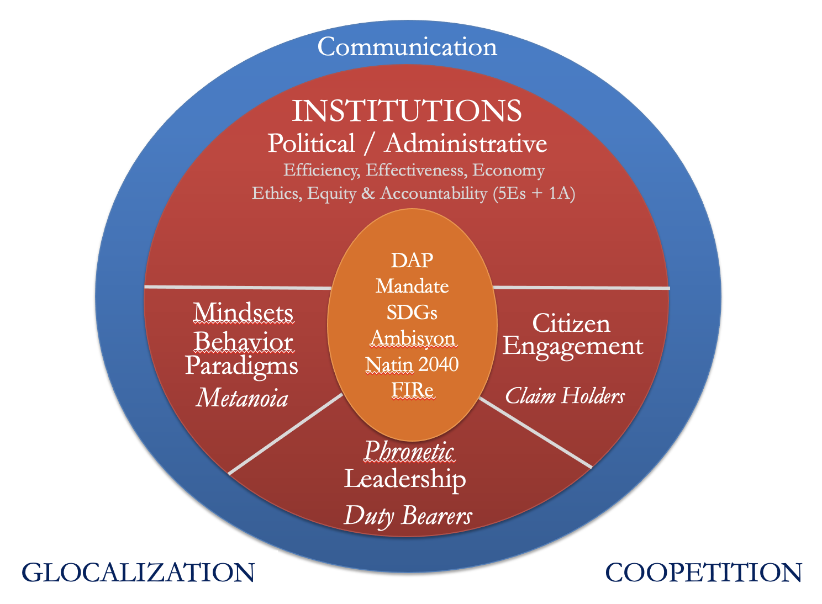
Governance Reform Framework
(Brillantes and Perante-Calina 2018)

Slide 27
Futures Leadership and Governance Framework (Perante-Calina 2020)
6 Abilities of a Phronetic Leader
1) Ability to set a good goal and make judgment on goodness
2) Ability to perceive reality as it is
3) Ability to create the ba
4) Ability to articulate the essence into narratives
5) Ability to exercise political power to achieve an envisioned story
6) Ability to foster phronesis in others
PHRONETIC LEADERSHIP
Vision
To build a just and humane society
Filipino Values
Bayanihan
Balikatan
Malasakit
Galang
Ugnayan
Pananagutan
Motto
Maka-Diyos, Makatao
Maka-Kalikasan
Maka-Bansa
FUTURES THINKING
HIRAYA FORESIGHT
PREFERRED
FUTURE
KNOWLEDGE CO-CREATION
COMMON GOOD
WELL- BEING
a bid for a holistic approach to carving out desirable futures

Slide 28
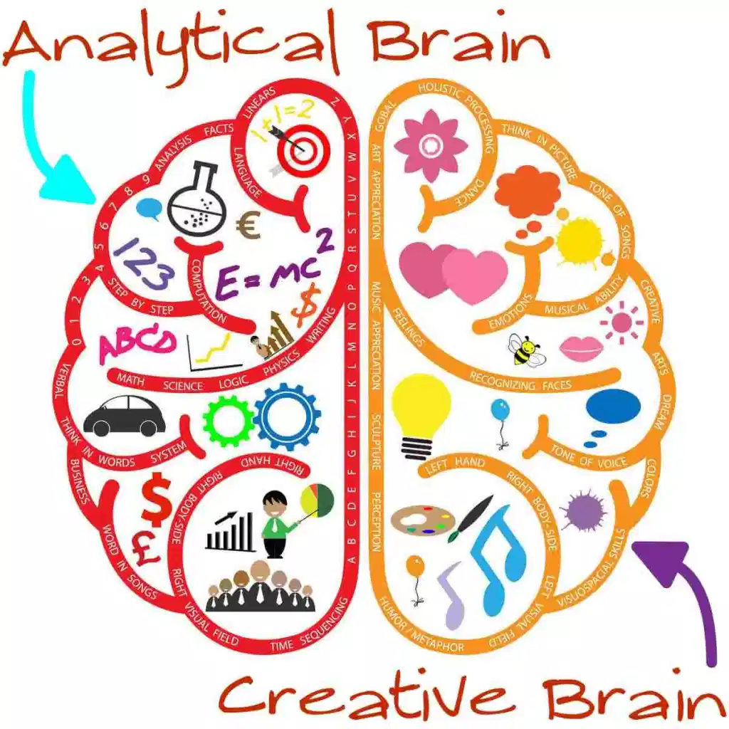
Futures Thinking & Strategic Foresight
heightens ability to
SENSE. SHAPE. ADAPT
to what happens in the years ahead
-Scoblic 2020
http://i0.wp.com/www.nwedible.com/wp-content/uploads/2015/03/Creative-Brain.jpg?resize=1024%2C1024

Slide 29
Benefits of Doing Foresight
Q: Why should I embark on a Foresight exercise?
Generate new ideas and approaches to a policy or strategy area
Explore innovative ways of responding to policy challenges
Shift the focus of senior leader/management dialogue towards the long term
Improve the culture of strategic thinking to be more agile, adaptive, proactive and future-facing
Show or attain ‘thought leadership’ on a given topic
Government Office for Science, The Futures Toolkit, 2017
Notes:
Generate new ideas and approaches to a policy or strategy area and explore innovative ways of responding to policy challenges
Shift the focus of senior leader/management dialogue towards the long term
Help improve the culture of strategic thinking to be more agile, adaptive, proactive and future-facing
Show or attain ‘thought leadership’ on a given topic

Slide 30
Benefits of Doing Foresight
Better anticipation: to identify and prepare sooner for new opportunities and challenges that could emerge in the future;
Policy innovation: to spur new thinking about the best policies to address these opportunities and challenges;
Future-proofing: to stress-test existing or proposed strategies against a range of future scenarios.
Notes:
Generate new ideas and approaches to a policy or strategy area and explore innovative ways of responding to policy challenges
Shift the focus of senior leader/management dialogue towards the long term
Help improve the culture of strategic thinking to be more agile, adaptive, proactive and future-facing
Show or attain ‘thought leadership’ on a given topic

Slide 31
Benefits of Doing Foresight for Educators
Educators need to:
identify emerging issues
negotiate uncertainties
articulate scenarios
develop a common vision of the desired future introduce innovation, and
design robust education policies and strategies often despite limited resources and a complex environment.
https://development.asia/explainer/why-foresight-matters-policy-makers?fbclid=IwAR1jPnolcAFfcoiN0y_4wV_lWIzplJRWO75uRGcgbdnH7f0rsHWl9KCqPI4
Notes:
Futures thinking or futures studies has been introduced by many management practitioners, who call themselves “futurists” or “foresight practitioners”, in the past two decades. Under futures thinking, foresight is the widely used concept, which is defined as a “systematic and long-term in-depth study on scientific, technical, economic, environmental, and social processes” (Chen and Chiang 2010, p 3). Foresight has something to do with brain science that when searching for the future, the mind is wired with the past (Innayatullah 2018)

Slide 32
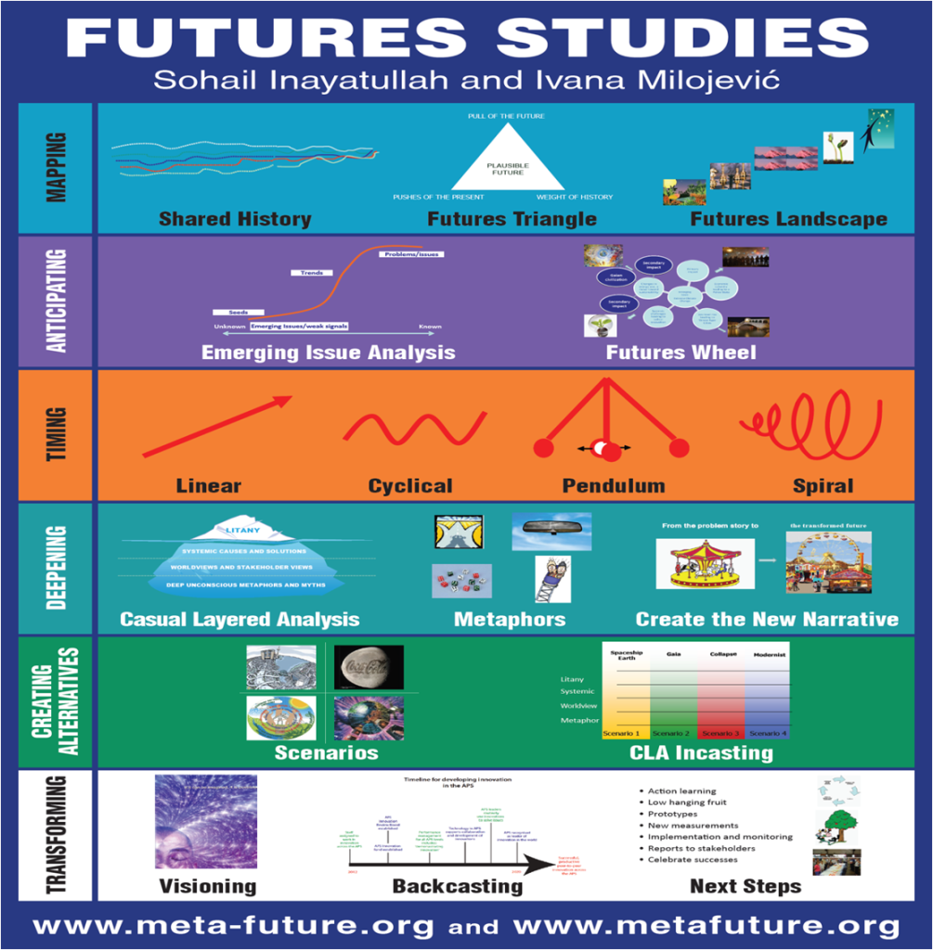
Futures Thinking and Policy Foresight Tools
`
Notes:
Futures thinking or futures studies has been introduced by many management practitioners, who call themselves “futurists” or “foresight practitioners”, in the past two decades. Under futures thinking, foresight is the widely used concept, which is defined as a “systematic and long-term in-depth study on scientific, technical, economic, environmental, and social processes” (Chen and Chiang 2010, p 3). Foresight has something to do with brain science that when searching for the future, the mind is wired with the past (Innayatullah 2018)

Slide 33
What could be the futures of the Philippine Educational System?

Slide 34
Some predictions on what the future of Philippine education will look like:
Formal education will be replaced by training programs for employability.
Better internet penetration will accelerate online learning.
A lot of startups will venture into education.
There will be a shift to ‘smart’ classrooms.
CIIT Philippines

Slide 35
The ideal future of education must instead value, recognize, and hone the individuality of each learner.
-Based from the Senate Committee Report by Senator Pia S. Cayetano, Chair of the Committee on Sustainable Development Goals, Innovation and Futures Thinking

Slide 36
HIRAYA FORESIGHT: AN
INDIGENOUS APPROACH
TOWARDS A
FUTURES-READY
EDUCATORS AND LEARNERS
Notes:
BUT IN THIS PRESENTATION, AN INDIGENOUS APPROACH IS PRESENTED.

Slide 37
WHAT IS HIRAYA AND WHY?
The only word that gives the potential of the future, of tomorrow, to illuminate on the present
Kinabukasan, or future.
Hiraya glows and radiates
An Ancient Word
(for it subsumes a lot of unexpressed meaning-significances and meaning-implications)
Notes:
^{WHAT IS HIRAYA?......}

Slide 38
Suggested Key Areas
HIRAYA FORESIGHT: AN
INDIGENOUS APPROACH
TOWARDS A
FUTURES-READY
EDUCATORS AND LEARNERS
Engage in current trends
Catalyst of change
Effective communicators
Morally upright
Socially responsible
Ability to challenge the norm vs the new norm (dictated, implied or backed up by data)
Notes:
BUT IN THIS PRESENTATION, AN INDIGENOUS APPROACH IS PRESENTED.

Slide 39
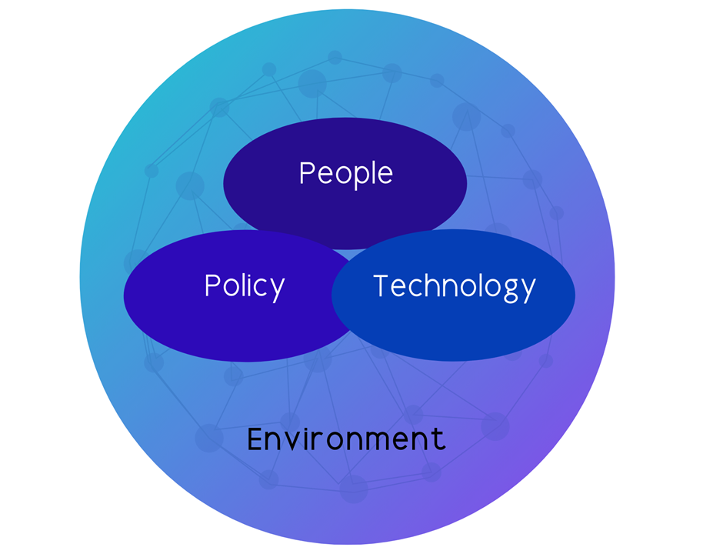
Factual Evidence + Human Dimension
People
Knowledge Sharing and Empowerment
Discipline and Individual Responsibility
Community Engagement
Technology
Strengthen Surveillance, Contact Tracing,
Infection prevention and control with the
use Artificial Intelligence and Internet of
Things
Policy
Futures Thinking
Strategic Foresight
Future-Ready Strategies
Evidence-Based
Brillantes, Domingo, Flores, Perante-Calina and Uggadan 2020

Slide 40
IMAGINATION IS THE CURRENCY
OF THE FUTURE

Slide 41
RETHINK. REFRAME. RETOOL. RESKILL.REENERGIZE.
5Rs
REMEMBER THE 5Rs.

Slide 42
CREATING SUSTAINABLE RESULTS TODAY FOR TOMORROW

Slide 43
RETHINKING
EDUCATION & LEARNING
© Getty Images/Colin Anderson Productions
https://unescochair-ghe.org/2020/02/13/unescos-futures-of-education-initiative/

Slide 44
UNESCO’s Futures of Education Initiative
REIMAGINE knowledge, education and learning
in a world of increasing complexity, uncertainty, and precarity.
https://unescochair-ghe.org/2020/02/13/unescos-futures-of-education-initiative/

Slide 45
UNESCO’s Futures of Education Initiative
humanistic approach to education and development
approach is grounded in a vision of development
Vision
economically inclusive, socially just, and environmentally sustainable.
https://unescochair-ghe.org/2020/02/13/unescos-futures-of-education-initiative/

Slide 46
UNESCO’s Futures of Education Initiative
knowledge for the future must be inherently plural.
make education relevant and equip learners with the skills to tackle the societal challenges of the future
https://unescochair-ghe.org/2020/02/13/unescos-futures-of-education-initiative/#_ftn1

Slide 47
UNESCO’s Futures of Education Initiative
Learning leadership in schools, rather than school management;
Learning resources and learning environments, rather than educational finance or school equipment;
Teachers as professionals of learning, rather than as a teaching force
https://unescochair-ghe.org/2020/02/13/unescos-futures-of-education-initiative/

Slide 48
UNESCO’s Futures of Education Initiative
Tests and examinations as assessments for learning, rather than assessment of learning;
Technologies as a means of liberating learners, rather than as a way of replacing teachers
https://unescochair-ghe.org/2020/02/13/unescos-futures-of-education-initiative/

Slide 49
Senate Resolution No. 413, May 21, 2020
WHEREAS, xxx
WHEREAS, xxx

Slide 50
CHANGING MINDSETS IS IMPORTANT
Imprisoned by fear of change, innovation and risk
Culture
Inter-generational Responsibility
Values
Regenerative
Society 5.0
Ethics
Nature

Slide 51
Green Education System
As a response to Senate Resolution 413
Developing new competencies in teaching
Establishing international collaboration
Facilitating green technology and innovation

Slide 52
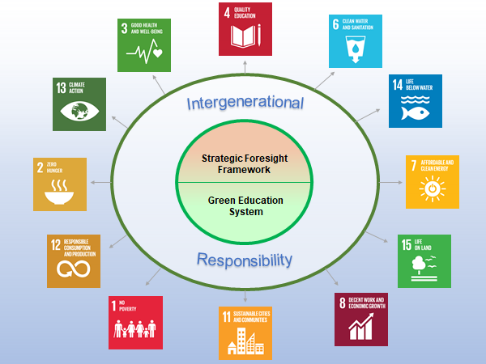
Green Education System
Source:https://sustainabledevelopment.un.org/?menu=1300

Slide 53
OECD LEARNING FRAMEWORK 2030
offers a vision and some underpinning principles for
THE FUTURE OF EDUCATION SYSTEMS (OECD, 2018)
Education 2030: A Shared Vision
committed to helping every learner develop as a whole person
fulfill his or her potential and help shape a shared future
built on the well-being of individuals, communities and the planet.
Source:https://www.oecd.org/education/2030/E2030%20Position%20Paper%20(05.04.2018).pdf?fbclid=IwAR0GeW56JF06cZlpDZ7QXzSFkiHm2Kln9WOjTmdFxYE4-lfe9vhCCEHjVeI
Notes:
In the face of an increasingly volatile, uncertain, complex and ambiguous world, education can make the difference as to whether people embrace the challenges they are confronted with or whether they are defeated by them. And in an era characterised by a new explosion of scientific knowledge and a growing array of complex societal problems, it is appropriate that curricula should continue to evolve, perhaps in radical ways.

Slide 54
OECD LEARNING FRAMEWORK 2030
new solutions in a rapidly changing world (esp.environmental, economic and social challenges)
2. broader education goals: Individual
and collective well-being
3. a broad set of knowledge, skills,
attitudes and values in action
Source:https://www.oecd.org/education/2030/E2030%20Position%20Paper%20(05.04.2018).pdf?fbclid=IwAR0GeW56JF06cZlpDZ7QXzSFkiHm2Kln9WOjTmdFxYE4-lfe9vhCCEHjVeI
Notes:
Students who are best prepared for the future are change agents. They can have a positive impact on their surroundings, influence the future, understand others' intentions, actions and feelings, and anticipate the short and long-term consequences of what they do. The concept of competency implies more than just the acquisition of knowledge and skills; it involves the mobilisation of knowledge, skills, attitudes and values to meet complex demands.

Slide 55
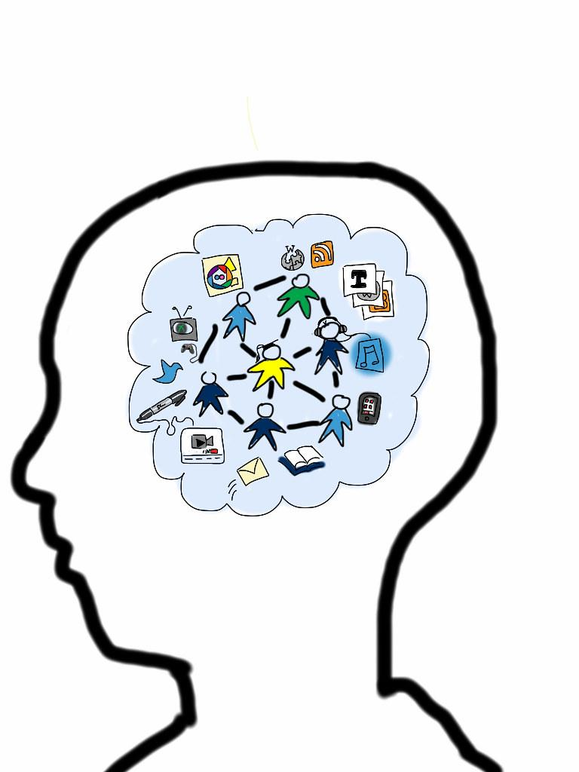
OECD LEARNING FRAMEWORK 2030
Learner agency: Navigating through a complex and uncertain world (OECD, 2018)
Future-ready students need to exercise agency, in their own education and throughout life
Agency implies a sense of responsibility to participate in the world and, in so doing, to influence people, events and circumstances for the better.
Source:https://www.oecd.org/education/2030/E2030%20Position%20Paper%20(05.04.2018).pdf?fbclid=IwAR0GeW56JF06cZlpDZ7QXzSFkiHm2Kln9WOjTmdFxYE4-lfe9vhCCEHjVeI

Slide 56
OECD LEARNING FRAMEWORK 2030
To help enable agency, educators must acknowledge both learner’s individuality and set of relationships that affect learning. (OECD, 2018)
CO- AGENCY - the interactive, mutually supportive relationships that help learners to progress towards their valued goals.
Source:https://www.oecd.org/education/2030/E2030%20Position%20Paper%20(05.04.2018).pdf?fbclid=IwAR0GeW56JF06cZlpDZ7QXzSFkiHm2Kln9WOjTmdFxYE4-lfe9vhCCEHjVeI
Notes:
relationships – with their teachers, peers, families and communities – t

Slide 57
OECD LEARNING FRAMEWORK 2030
COMPETENCIES TO TRANSFORM OUR SOCIETY AND SHAPE OUR FUTURE
Creating new value
Reconciling tensions and dilemmas
Taking responsibility
Source:https://www.oecd.org/education/2030/E2030%20Position%20Paper%20(05.04.2018).pdf?fbclid=IwAR0GeW56JF06cZlpDZ7QXzSFkiHm2Kln9WOjTmdFxYE4-lfe9vhCCEHjVeI

Slide 58
OECD LEARNING FRAMEWORK 2030
Design principles for moving toward an eco-systemic change (OECD, 2018)
Concept, content and topic design:
Student Agency. Curriculum designed around motivating students and recognizing their KSA, and values
Rigor. Challenging and thought-provoking topics
Focus. Relatively fewer topics per grade to ensure depth and quality learning
Coherence. Logically sequenced topics enabling progression from basic to advanced
Alignment. Curriculum aligned with teaching and assessment practices
Transferability. Higher priority to learnings that can be learned in one context and transferred to others
Choice. Diverse topics and project options for students; opportunity to suggest their own project
Source:https://www.oecd.org/education/2030/E2030%20Position%20Paper%20(05.04.2018).pdf?fbclid=IwAR0GeW56JF06cZlpDZ7QXzSFkiHm2Kln9WOjTmdFxYE4-lfe9vhCCEHjVeI

Slide 59
OECD LEARNING FRAMEWORK 2030
Design principles for moving toward an eco-systemic change (OECD, 2018)
Process Design:
Teacher Agency. Empowered educators to deliver curriculum effectively
Authenticity. Ability of learners to link learning experiences to real world
Inter-relation. Learners are opportuned to connect topics across disciplines
Flexibility. “adaptable and dynamic” curriculum that reflects evolving societal requirements and learning needs.
Engagement. Teachers, students and other stakeholders are involved in the development of curriculum to ensure ownership of implementation
Source:https://www.oecd.org/education/2030/E2030%20Position%20Paper%20(05.04.2018).pdf?fbclid=IwAR0GeW56JF06cZlpDZ7QXzSFkiHm2Kln9WOjTmdFxYE4-lfe9vhCCEHjVeI

Slide 61
Thus: Hiraya, a Beacon of Light, Wisdom, and Hope
Many other countries in Asia and the Pacific, indigenous concepts abound that are rich in cultural and social contexts, which may be harnessed to build up a futures thinking framework for the education sector.
It is only through going back to our indigenous roots that we find local wisdom in our own country
Notes:
PhilFutures has chosen the appropriate indigenous concept as our linguistic-visual icon.
Hiraya as a foresight concept and approach subsumes other meanings and connotations. This indigenous concept actually opens up a veritable cache of other indigenous concepts that are similarly rich in such meaning-implications and meaning-significances.
I am similarly confident that in many other countries in Asia and the Pacific, indigenous concepts abound that are rich in cultural and social contexts. For example, in Indonesia, Malaysia and Singapore, where the Malay language reigns, there are words like gotong royong (mutual assistance), and masyarakat (society or community), which may be harnessed to build up a futures thinking framework for the public sector.
It is only through going back to our indigenous roots that we find local wisdom in our own country.

Slide 62
On the Philippine Education System
Change is inevitable and constant. In order to remain relevant in the post-COVID world, the Philippine education system will have to adapt to the times. There is a need to shake things up for the youth to be employable and globally competitive. Technology will play a key role in this dramatic change.
-CIIT Philippines
Notes:
PhilFutures has chosen the appropriate indigenous concept as our linguistic-visual icon.
Hiraya as a foresight concept and approach subsumes other meanings and connotations. This indigenous concept actually opens up a veritable cache of other indigenous concepts that are similarly rich in such meaning-implications and meaning-significances.
I am similarly confident that in many other countries in Asia and the Pacific, indigenous concepts abound that are rich in cultural and social contexts. For example, in Indonesia, Malaysia and Singapore, where the Malay language reigns, there are words like gotong royong (mutual assistance), and masyarakat (society or community), which may be harnessed to build up a futures thinking framework for the public sector.
It is only through going back to our indigenous roots that we find local wisdom in our own country.

Slide 63
Conclusion and Recommendations
Cultivate FFT
Start small; then later institutionalize through intense, cooperative, collaborative education and training
A central unit, the National Institute on FT and Anticipatory Governance
Use of indigenous concepts like bayanihan and hiraya in the Philippines

Slide 64
MAIN MESSAGE
SKILL SETS AND COMPETENCIES REQUIRED
TO BE FUTURES-READY
Phronetic and Futurist
Educators
Foresight
Futures Thinking
Ethical Leadership
Design Thinking

Slide 65
www.philfutures.net
www.gspdm.com
www.pspaconference.com
HIRAYA MANAWARI!!!
lizanpcalina@gmail.com
0917.543.4511
Notes:
THROUGH EDUCATION AND TRAINING, CONFERENCES AND KNOWLEDGE CO-CREATION WITH DAP GRADUATE SCHOOL AND WORLD STAGE AT THE FOREFRONT, WE CAN FURTHER OUR DREAMS AND ASPIRATIONS FOR A GENERATIVE AND TRANFORMATIONAL FILIPINO COMMUNITY WITH AN ANTICIPATORY MINDSET

